Slide 1

The Normal Equation
Presented by:
Elizer Ponio Jr.
Department of Computer Science
College of Computing and Information Technologies

Slide 2
The Normal Equation
We know the Linear Regression model is a parameterized model which means that the model’s behavior and predictions are determined by a set of parameters or coefficients in the model.

Slide 3
The Normal Equation
Normal Equation is an approach to Linear Regression with the Least Square Cost Function.
We can use the normal equation to directly compute the parameters of a model that minimizes the sum of the squared difference between the actual term and the predicted term.

Slide 4
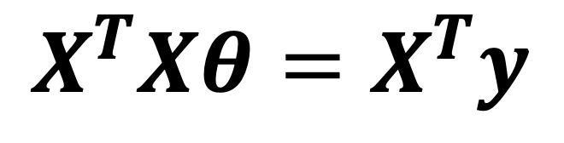
$$\text{The} \text{Normal} \text{Equation}$$
$X^{T}Xθ=X^{T}y$

Slide 5
$$\text{The} \text{Normal} \text{Equation}$$
Price of Fuel (X) | Jeepney Fare (Y)
1 | 1
2 | 3
3 | 2

Slide 6
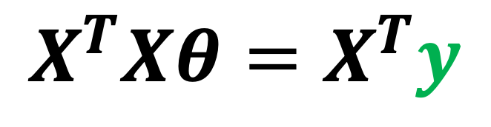
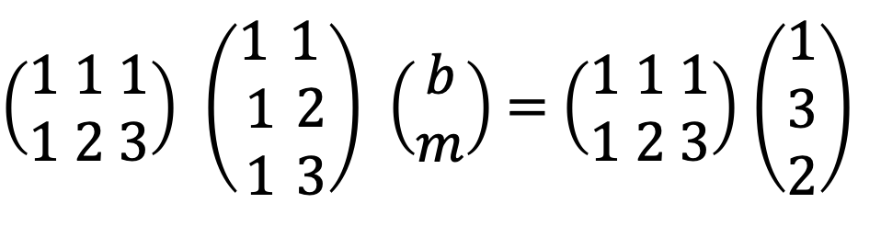
$$\text{The} \text{Normal} \text{Equation}$$
Price of Fuel (X) | Jeepney Fare (Y)
1 | 1
2 | 3
3 | 2
$X^{T}Xθ=X^{T}y$
$\left(\begin{aligned}1 1 1 \\ 1 2 3\end{aligned}\right)$ $\left(\begin{aligned}1 \\ 1 \\ 1\end{aligned}\begin{aligned}1 \\ 2 \\ 3\end{aligned}\right)$ $\left(\begin{aligned}b \\ m\end{aligned}\right)$ = $\left(\begin{aligned}1 1 1 \\ 1 2 3\end{aligned}\right)$ $\left(\begin{aligned}1 \\ 3 \\ 2\end{aligned}\right)$

Slide 7
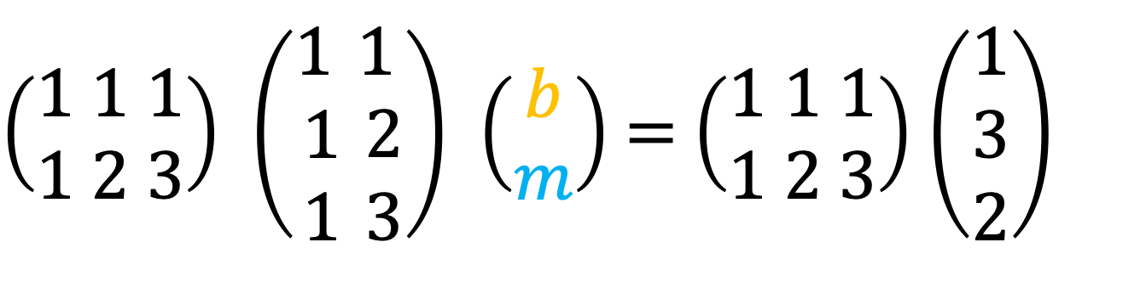
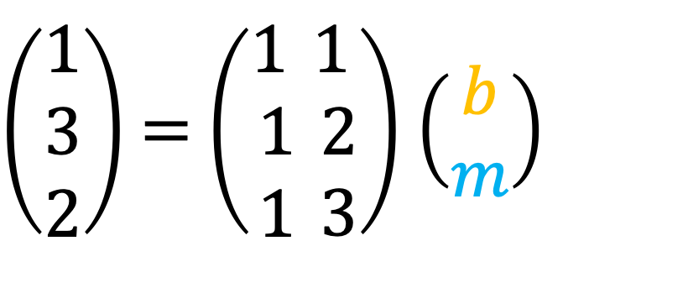
$$\text{The} \text{Normal} \text{Equation}$$
$\left(\begin{aligned}1 \\ 3 \\ 2\end{aligned}\right)$ = $\left(\begin{aligned}1 \\ 1 \\ 1\end{aligned}\begin{aligned}1 \\ 2 \\ 3\end{aligned}\right)$ $\left(\begin{aligned}b \\ m\end{aligned}\right)$
$\left(\begin{aligned}1 1 1 \\ 1 2 3\end{aligned}\right)$ $\left(\begin{aligned}1 \\ 1 \\ 1\end{aligned}\begin{aligned}1 \\ 2 \\ 3\end{aligned}\right)$ $\left(\begin{aligned}b \\ m\end{aligned}\right)$ = $\left(\begin{aligned}1 1 1 \\ 1 2 3\end{aligned}\right)$ $\left(\begin{aligned}1 \\ 3 \\ 2\end{aligned}\right)$

Slide 8
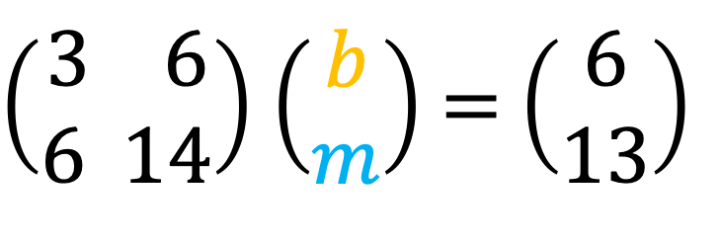
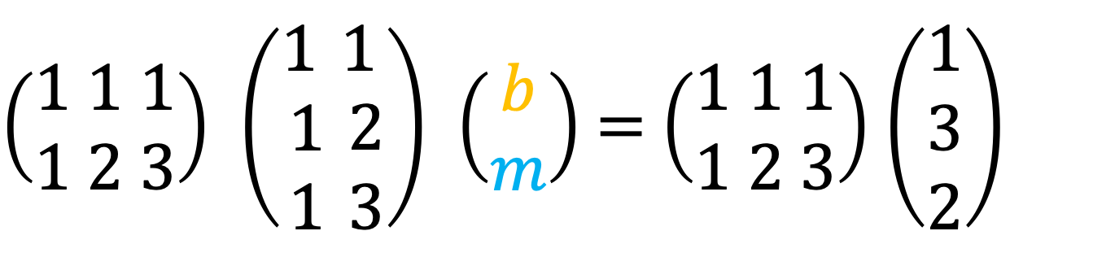
$$\text{The} \text{Normal} \text{Equation}$$
$\left(\begin{aligned}1 1 1 \\ 1 2 3\end{aligned}\right)$ $\left(\begin{aligned}1 \\ 1 \\ 1\end{aligned}\begin{aligned}1 \\ 2 \\ 3\end{aligned}\right)$ $\left(\begin{aligned}b \\ m\end{aligned}\right)$ = $\left(\begin{aligned}1 1 1 \\ 1 2 3\end{aligned}\right)$ $\left(\begin{aligned}1 \\ 3 \\ 2\end{aligned}\right)$
$\left(\begin{aligned}3 6 \\ 6 14\end{aligned}\right)$ $\left(\begin{aligned}b \\ m\end{aligned}\right)$ = $\left(\begin{aligned}6 \\ 13\end{aligned}\right)$

Slide 9
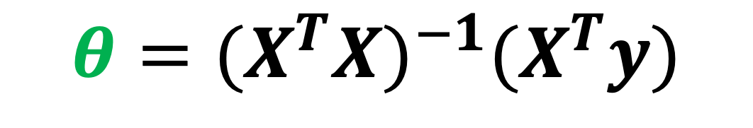
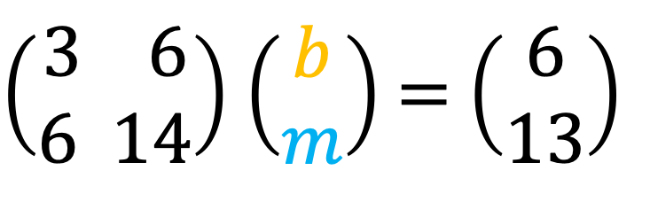
$$\text{The} \text{Normal} \text{Equation}$$
$\left(\begin{aligned}3 6 \\ 6 14\end{aligned}\right)$ $\left(\begin{aligned}b \\ m\end{aligned}\right)$ = $\left(\begin{aligned}6 \\ 13\end{aligned}\right)$
$$θ={{(X^{T}X)}^{−1}(X}^{T}y)$$

Slide 10
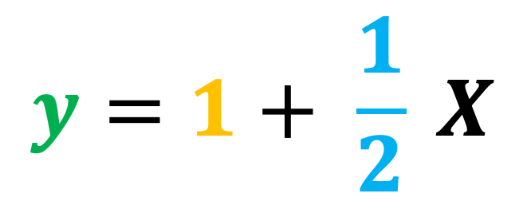
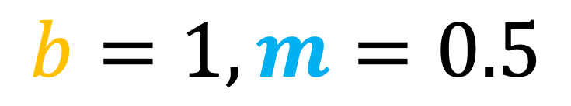
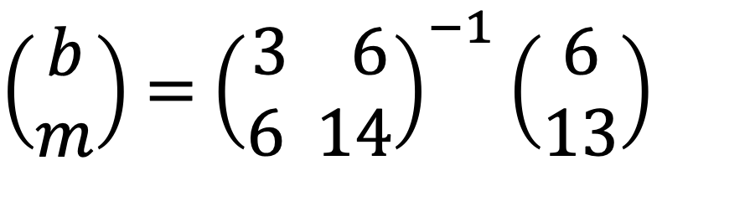

$$\text{The} \text{Normal} \text{Equation}$$
$\left(\begin{aligned}b \\ m\end{aligned}\right)$ = ${\left(\begin{aligned}3 6 \\ 6 14\end{aligned}\right)}^{−1}\left(\begin{aligned}6 \\ 13\end{aligned}\right)$
$$b=1, m=0.5$$
$$y=1+ \frac{1}{2} X$$

